Slide 1
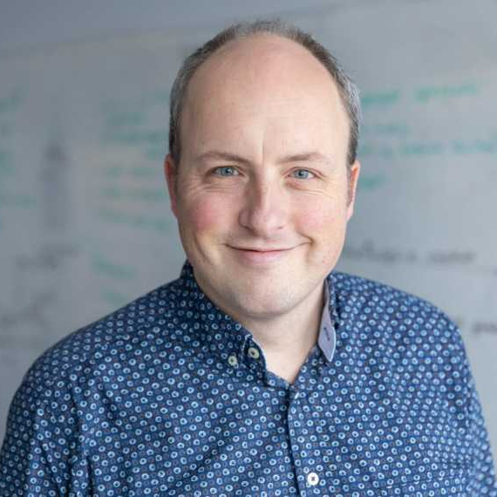
IT & environment:
an inconvenient combination?
Bernard van Gastel
Assistant professor sustainable digitalization
Software Science, Radboud University
Notes:
Hidden impact
Solutions
Steering developments
Our contributions

Slide 2
Our hidden impact
Notes:
digital divide: accessibility / inclusion / diversity
privacy / security
data driven society & bias & unfairness
distribution of information / mental health
This course deals with:
sustainability in IT: how can IT contribute to solving the above problems.
sustainability with IT: how can IT solve other sustainability challenges.

Slide 3
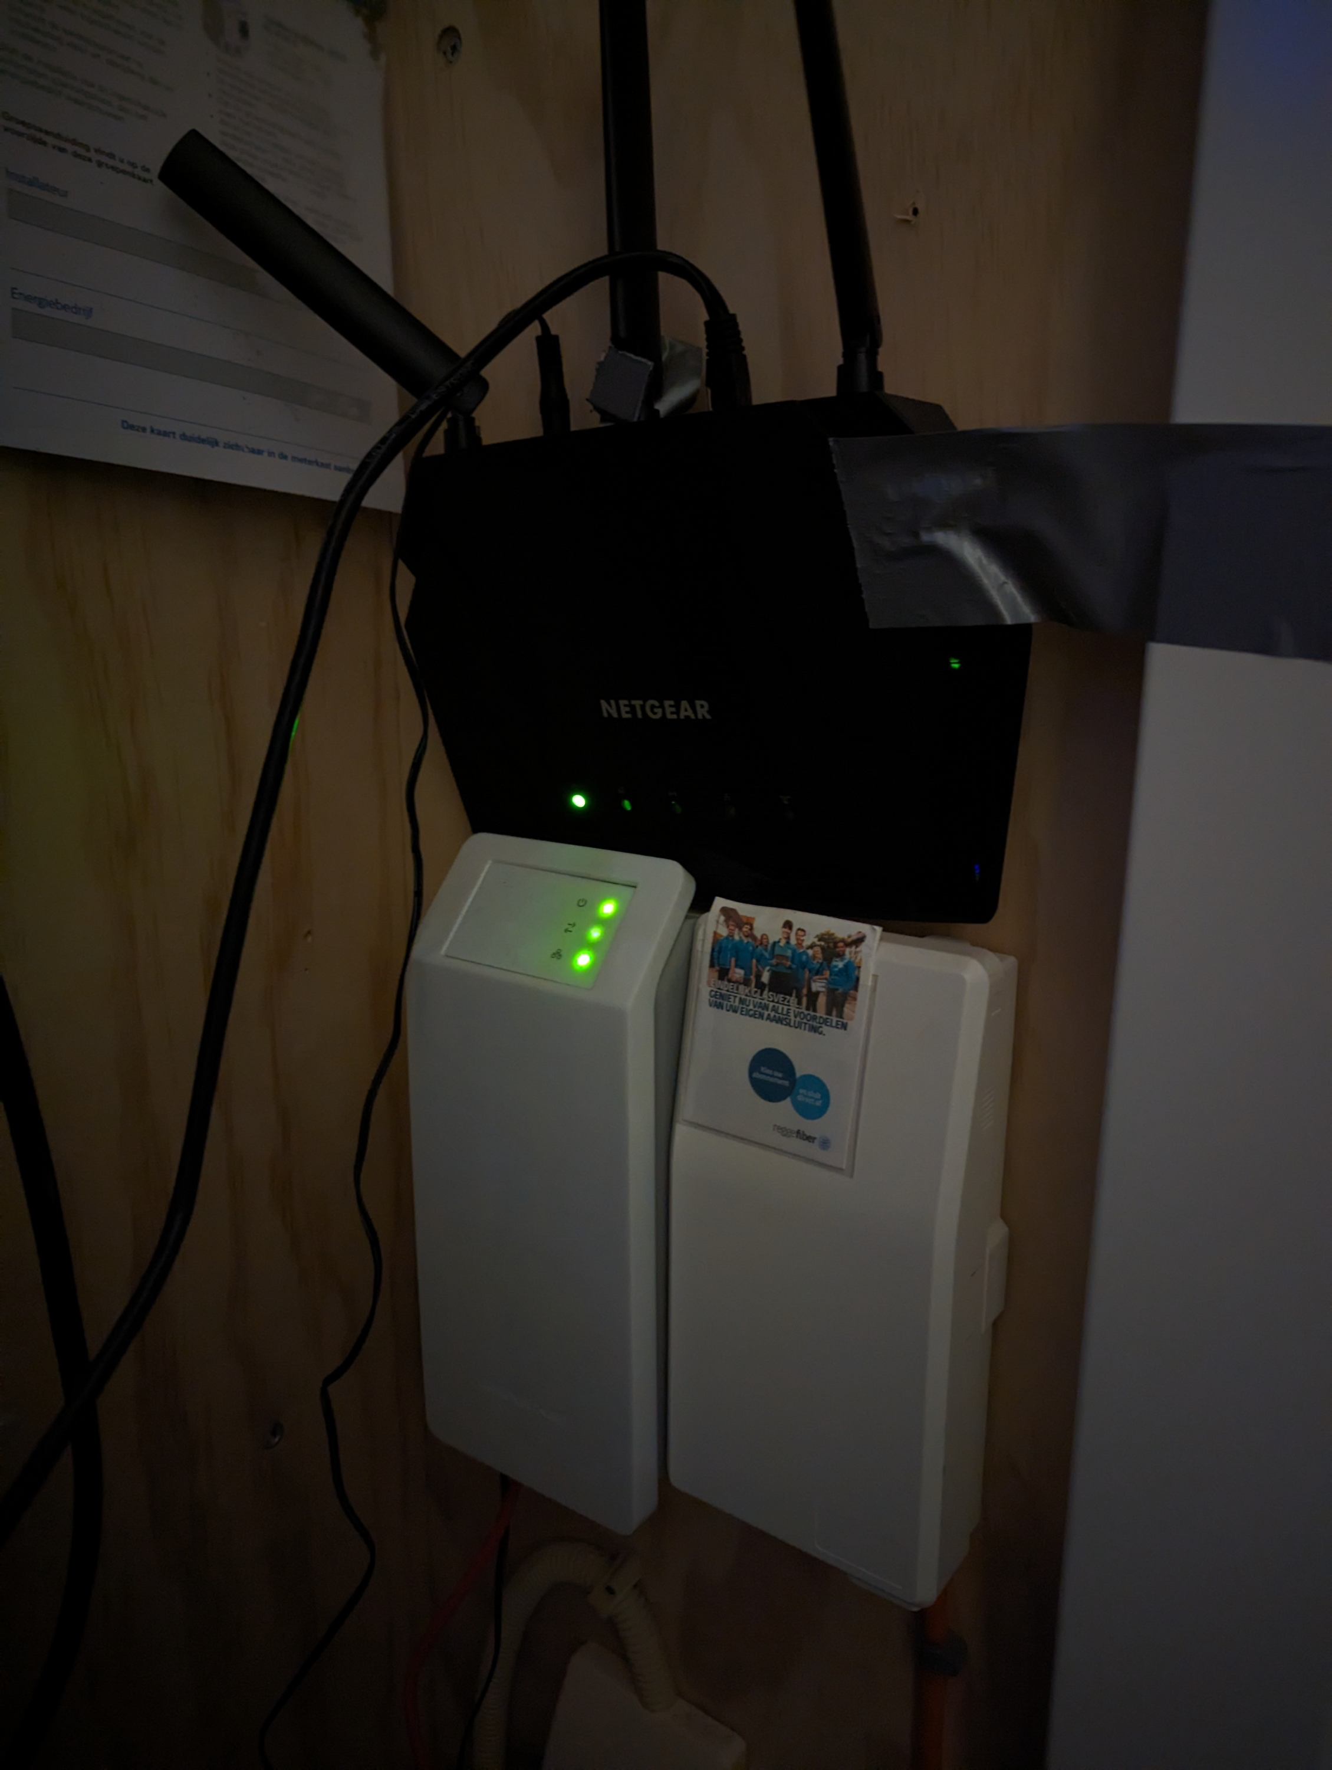
Internet…
Notes:
Fridge: 10
Afzuiging: 2.5
Wasmachine: 2.3
Wifi: 12 (24W -> 210 kWh)

Slide 4
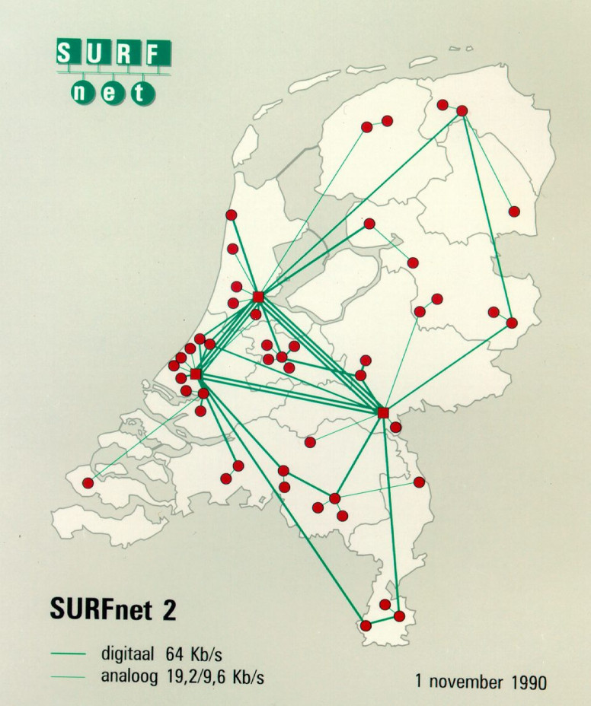
Internetdistance
Notes:
11 stappen voor YouTube
Aanbieders proberen zo dicht mogelijk bij de afnemers data te stallen. Populaire films sneller laden. Unpopulaire films duren langer, komen bv uit VS.

Slide 5
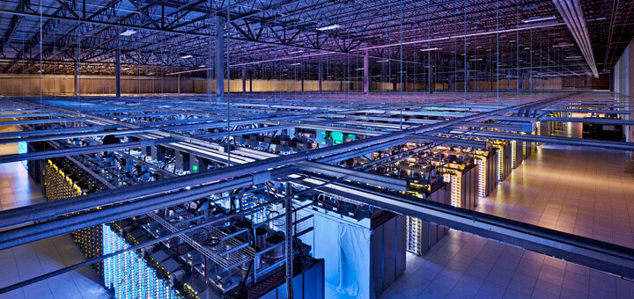
Provider / AMS-IX

Slide 6
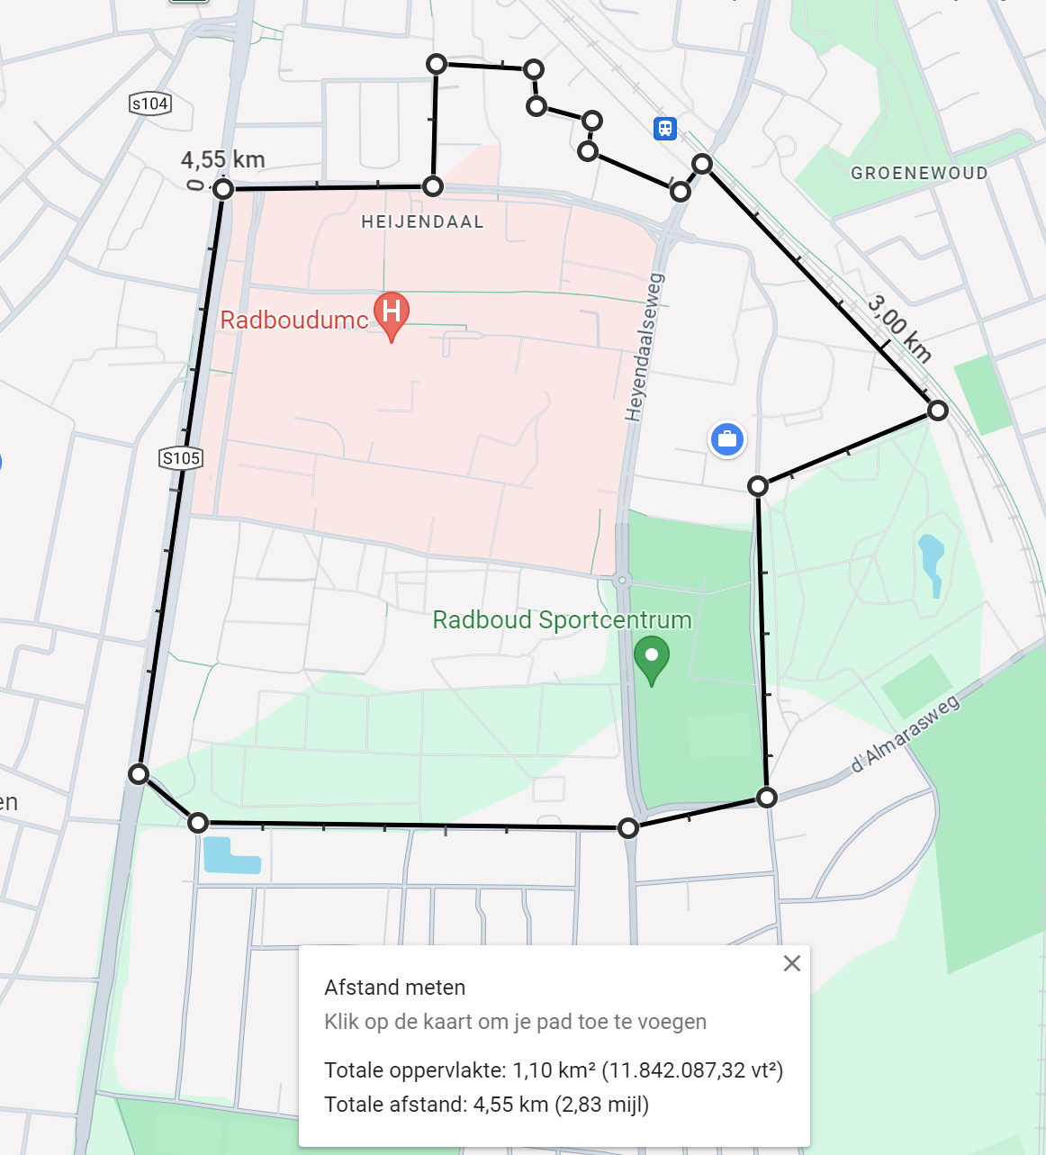
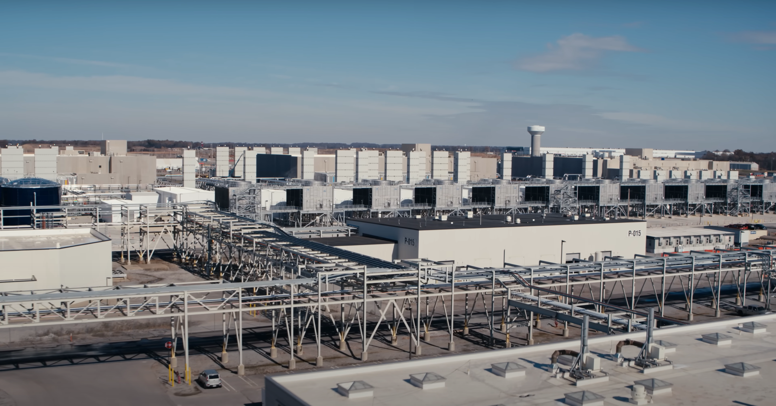
Datacenters
Notes:
Zeewolde = 1,66 km2, campus nijmegen 1 km2 (incl ziekenhuis). Banen op dat gebied: 410. Banen op campus: 17.000k
Claims van groene energie, die energie was anders ergens anders voor gebruikt.
Stroomverbruik Zeewolde datacentrum:
1,66 km
1380 GWh of electricity per year (14x RU)
400 jobs
1,10 km
99 -> 44 GWh (uni) + 55 GWh (2023; hospital) (https://www.radboudumc.nl/over-het-radboudumc/strategie/themas/duurzaamheid/onze-pijlers/duurzame-bedrijfsvoering/duurzame-bedrijfsvoering/energie#:~:text=Ons%20elektriciteitsverbruik%20is%20in%202023,is%20verbruikt%20voor%20deze%20koeling.)
17.000 jobs

Slide 7
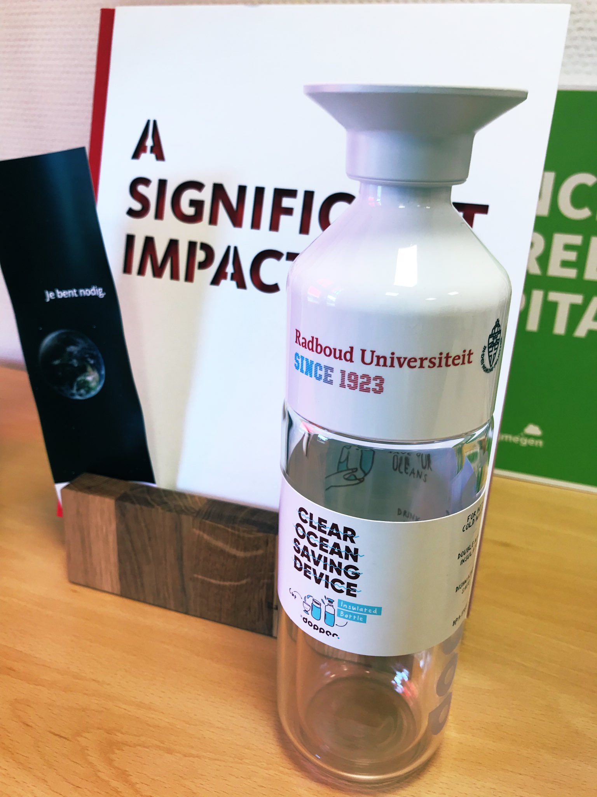

Slide 8
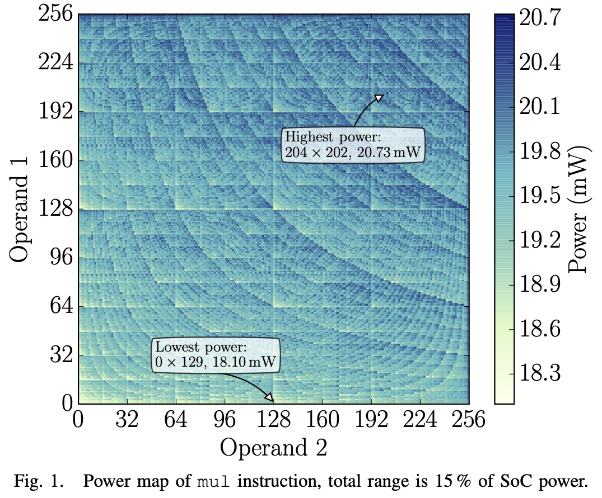
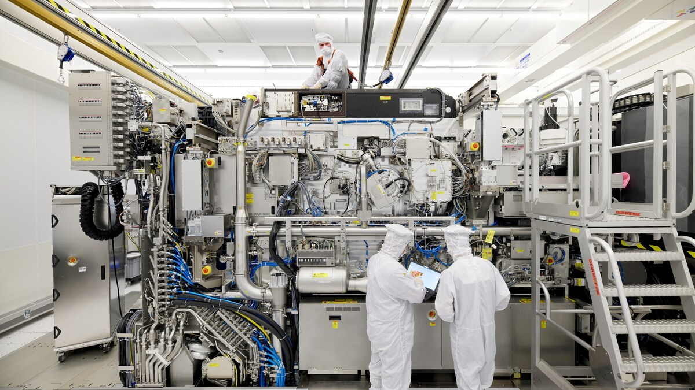
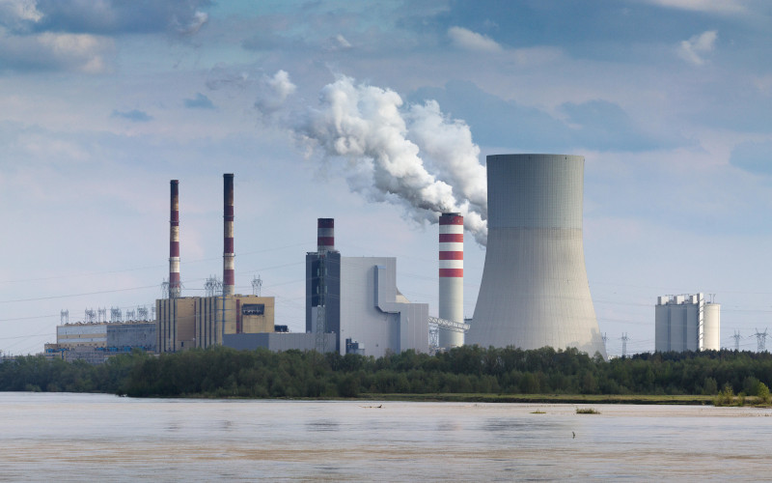
Impact of IT & AI
Materials/production
Energy cost
Rare earth materials
Working conditions
E-waste
In use
Compute
Storage
Transmission
Idle
https://arxiv.org/abs/1505.03374
Notes:
https://arxiv.org/abs/1505.03374

Slide 9
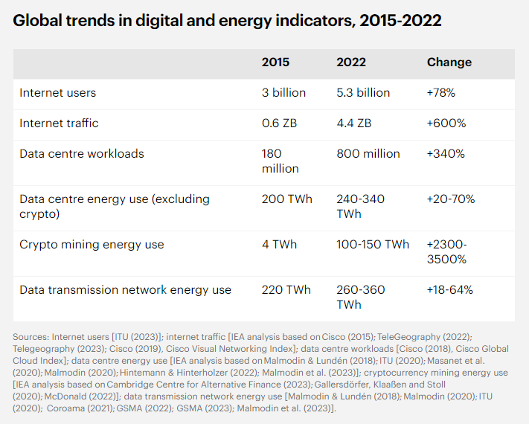
“Today, electricity consumption from data centres is estimated to amount to around 415 terawatt hours (TWh), or about 1.5% of global electricity consumption in 2024. It has grown at 12% per year over the last five years.” (IEA report on Energy demand from AI, 2024)
https://www.iea.org/energy-system/buildings/data-centres-and-data-transmission-networks
Notes:
From 2024 to 2030, data centre electricity consumption grows by around 15% per year, more than four times faster than the growth of total electricity consumption from all other sectors. (https://www.iea.org/reports/energy-and-ai/energy-demand-from-ai)
Edge computing: reduce need for networks
Estimated global data centre electricity consumption in 2022 was 240-340 TWh¹, or around 1-1.3% of global final electricity demand.
https://www.iea.org/energy-system/buildings/data-centres-and-data-transmission-networks

Slide 10
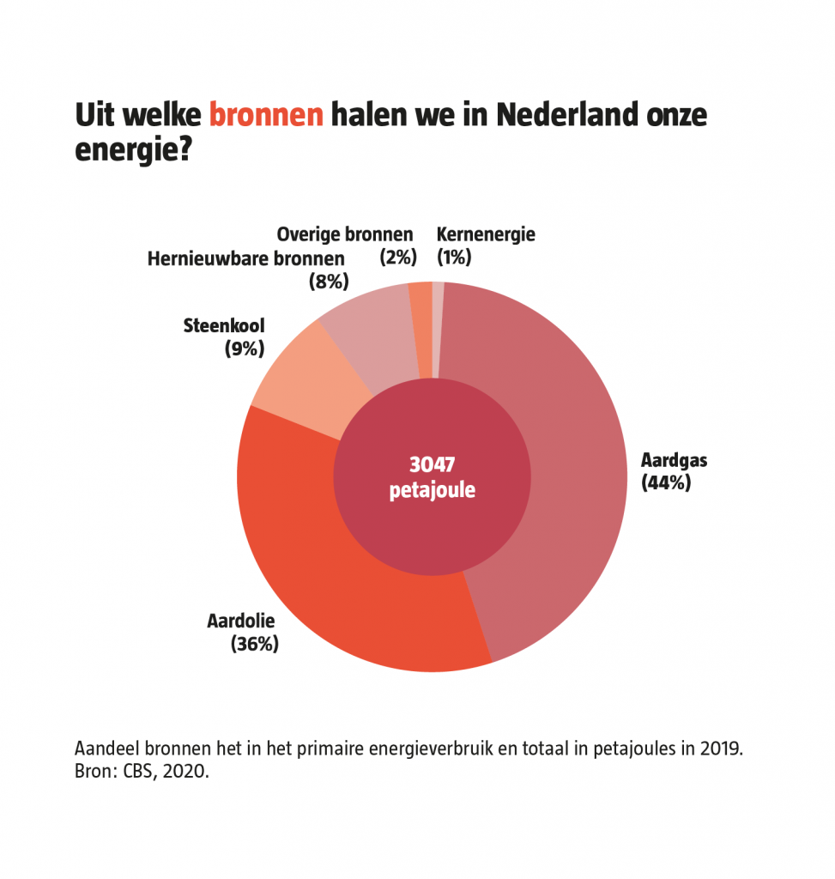
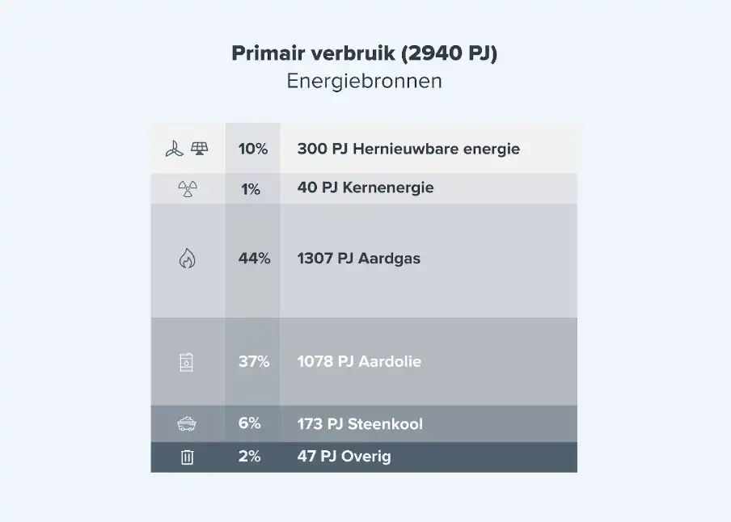
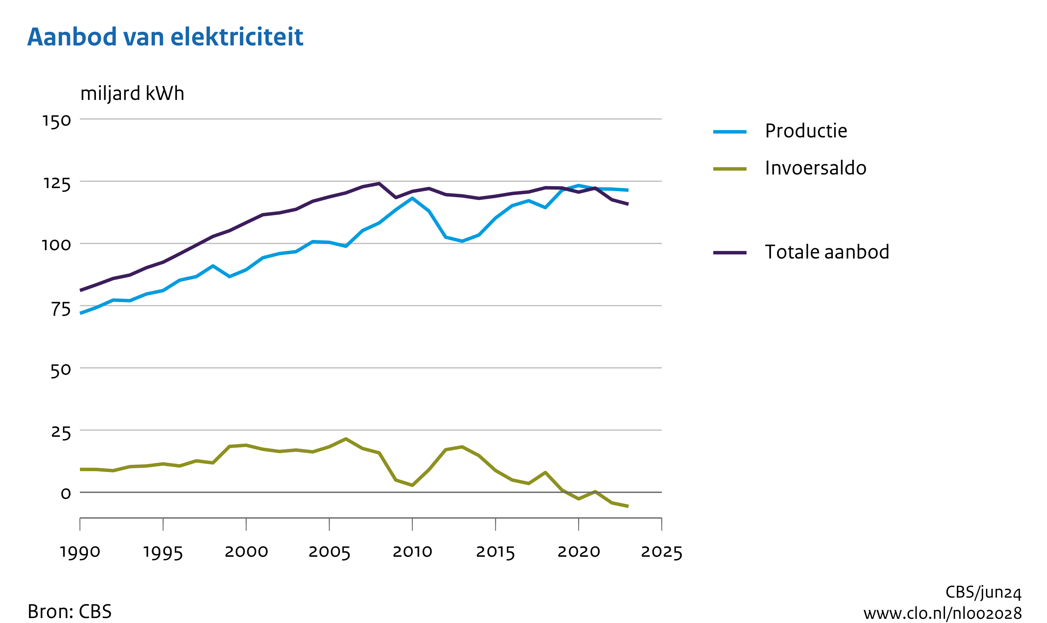
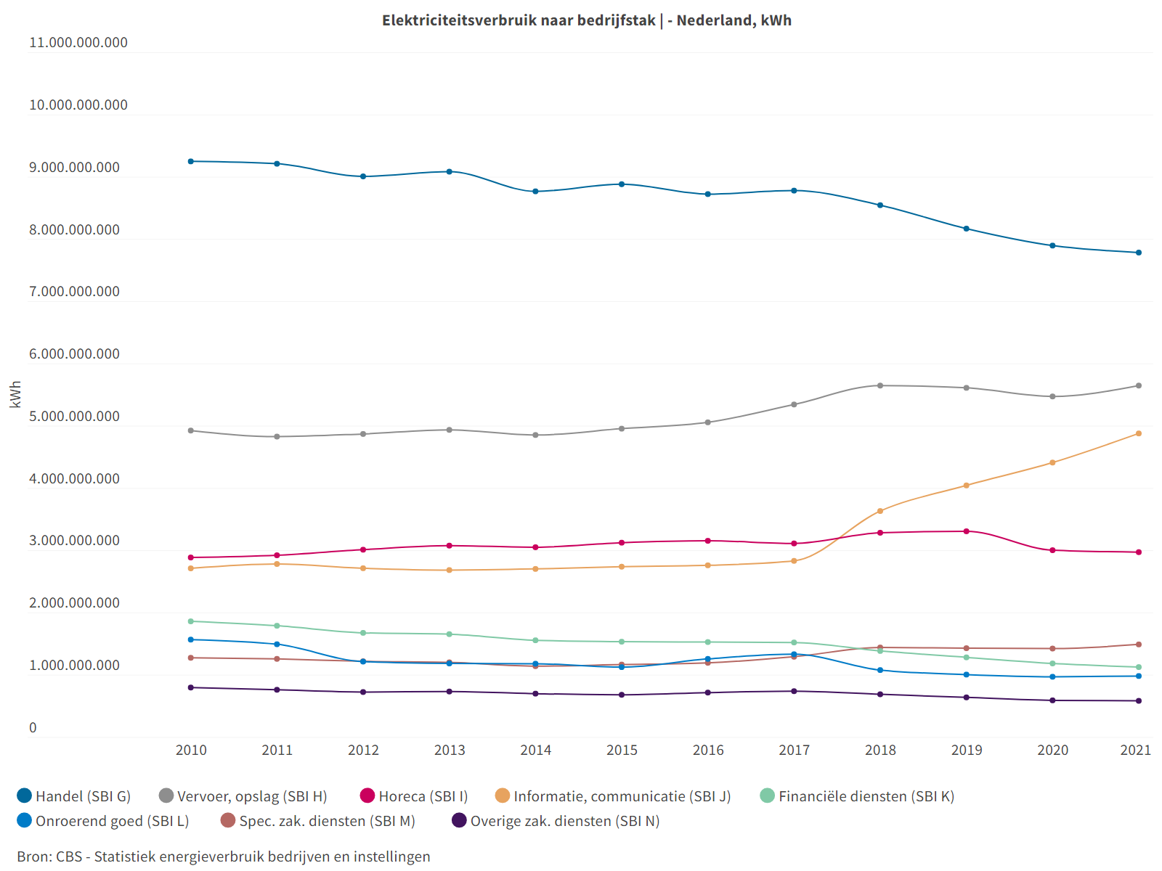
Elektra in NL
Notes:
Opbouw:
- warmte (55 procent, vooral gebouwen en industrie),
- transport (25 procent, vooral wegverkeer en vliegverkeer)
stroomverbruik (20 procent)
Primair verbruik: van de bron, 2023
https://www.clo.nl/indicatoren/nl002028-aanbod-en-verbruik-van-elektriciteit-1990-2023

Slide 11
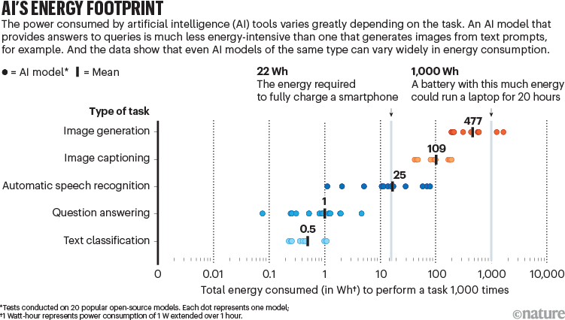
https://www.nature.com/articles/d41586-024-02680-3
Notes:
https://www.nature.com/articles/d41586-024-02680-3

Slide 12
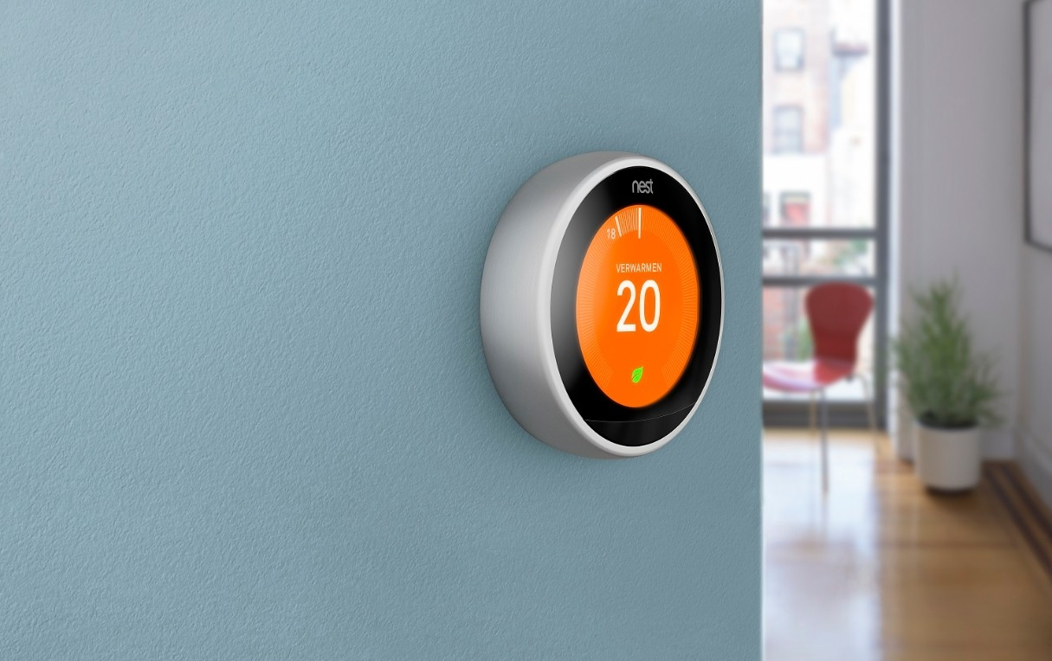
Notes:
Beware of overpromising, or unintended consequences
Nest smart thermostat promises savings... but
Might be (near) optimal already.
User preference matter a lot:
if you like a constant temperature, there is nothing to optimize
Region matter a lot (Scandinavia vs Spain).
All home or changing schedule makes it hard to learn your habits;
Weather patterns change every year;
In certain cases, might use more energy! Because people can now switch on the thermostat when away from home.... so more energy!

Slide 13
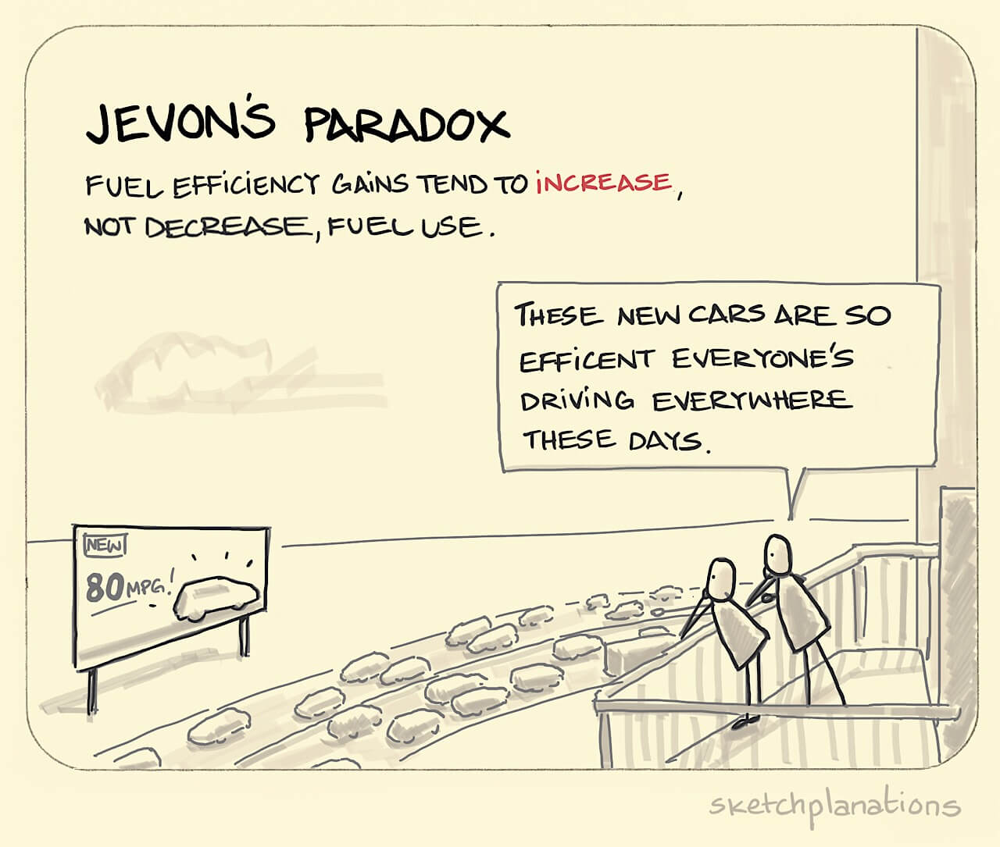
Restrained digitalization
Sometimes don’t
digitalize
Notes:
Nieuwe hardware bied geen oplossing.
Keuzes, of bij gebrek aan keuzes hogere energieprijzen.
Vaker niet digitaliseren en anders digitaliseren.
Sustainable IT is a 'wicked problem'
Because IT is all around us, and it is hard to:
predict behavior of humans;
predict behavior of software;
predict energy consumption of hardware.
Example questions:
how much does IT on the campus consume?
what is the effect of IT on mental health?
is it worth relying on IT (and Big Tech) in primary education?
should we solve IT problems with IT?
...

Slide 14
Solutions
Roy van der Steen, Bernard van Gastel: The organizational hurdles of structurally reducing the energy consumption of software. 2023. In Proceedings of BENEVOL 2023, 2023

Slide 15

solution 1
create ‘incentive’
Notes:
Maak een business case

Slide 16
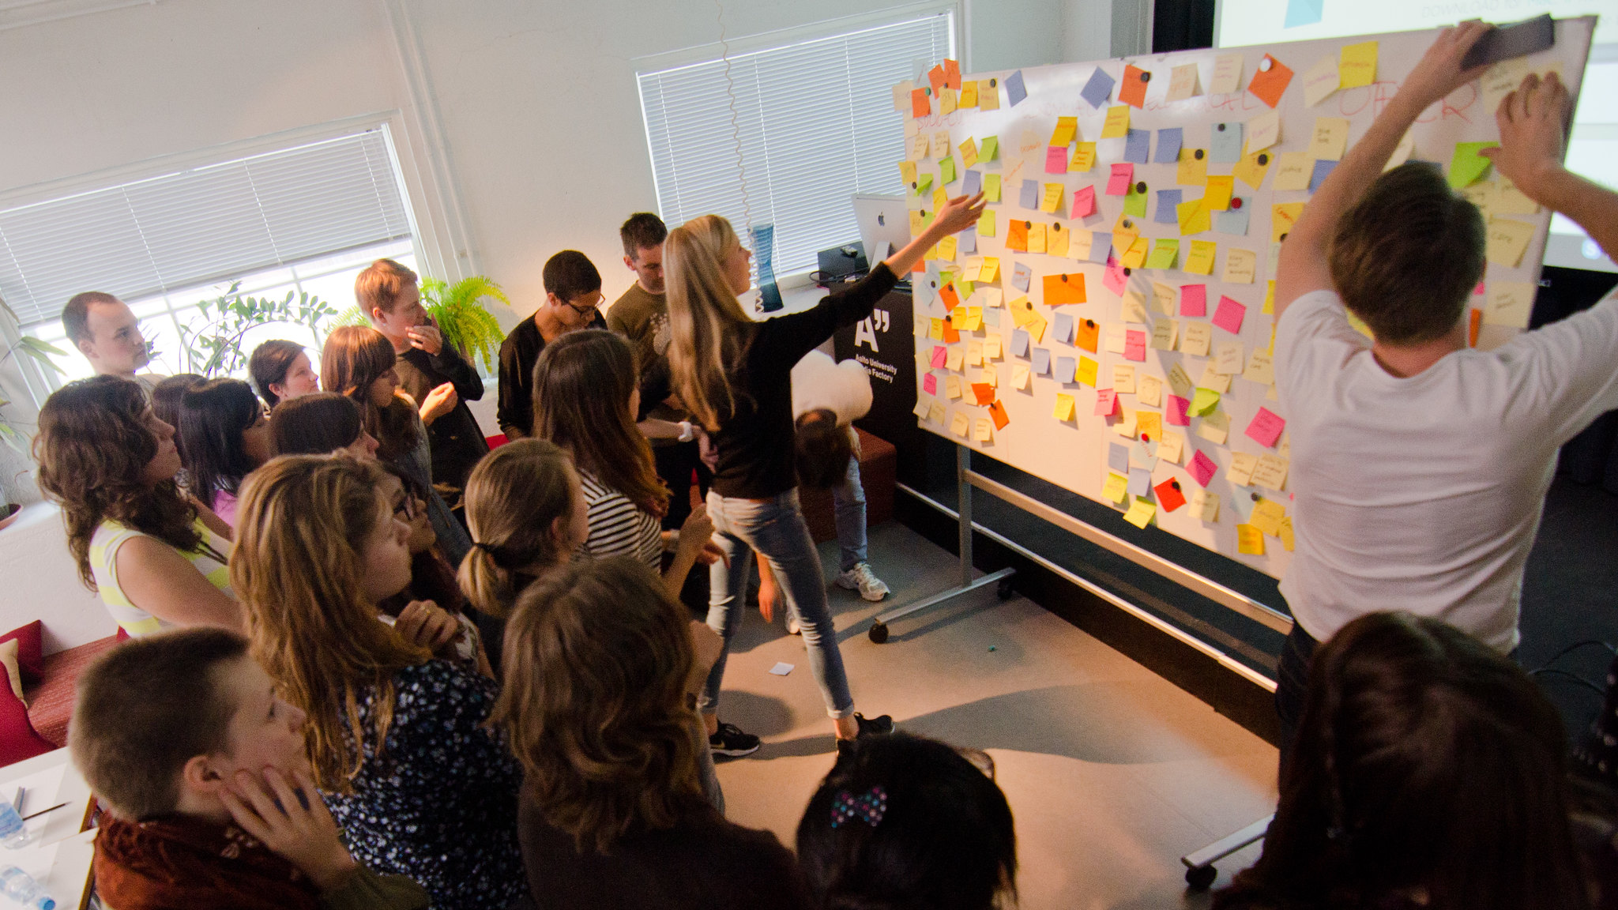
solution 2
support teamwork with right tooling and infrastructure
Notes:
Meer tools, meer maatwerk

Slide 17
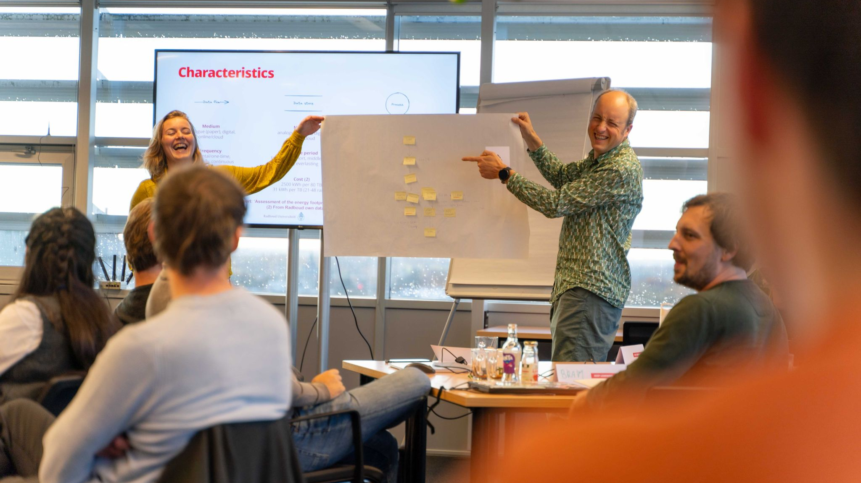
solution 3
share knowledge (and discuss misconceptions)
Notes:
Misvattingen tegengaan. Snel veranderende afwegingen. Dashboards.

Slide 18
Steering developments

Slide 19
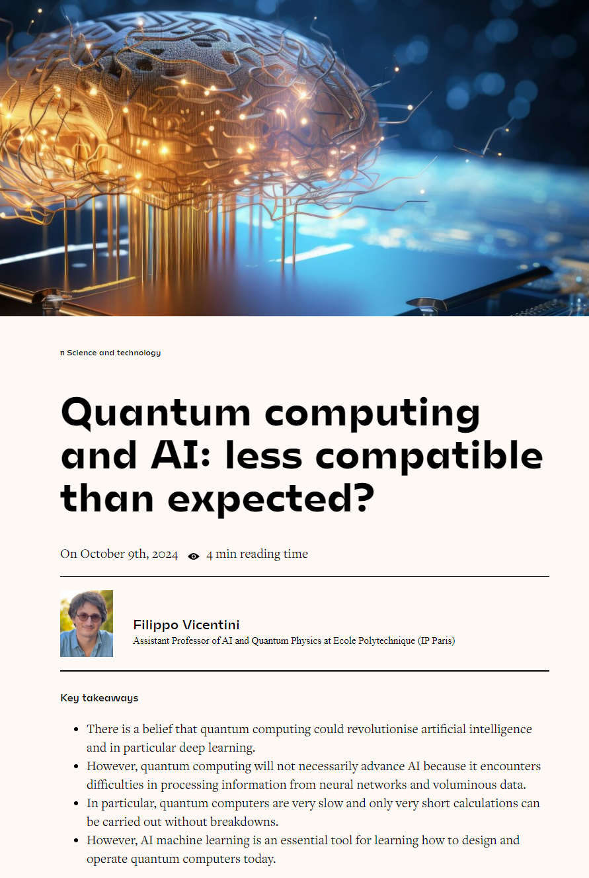
https://www.polytechnique-insights.com/en/columns/science/quantum-computing-and-ai-less-compatible-than-expected/
Notes:
https://www.polytechnique-insights.com/en/columns/science/quantum-computing-and-ai-less-compatible-than-expected/

Slide 20

The programming language is central to the Dutch Tax Authority's ICT infrastructure - in fact, 70% of all financial transactions are processed using COBOL.
https://www.binnenlandsbestuur.nl/digitaal/informatiehuishouding/hoe-een-stokoude-programmeertaal-de-overheid-in-zijn-greep
Notes:
https://www.binnenlandsbestuur.nl/digitaal/informatiehuishouding/hoe-een-stokoude-programmeertaal-de-overheid-in-zijn-greep

Slide 21
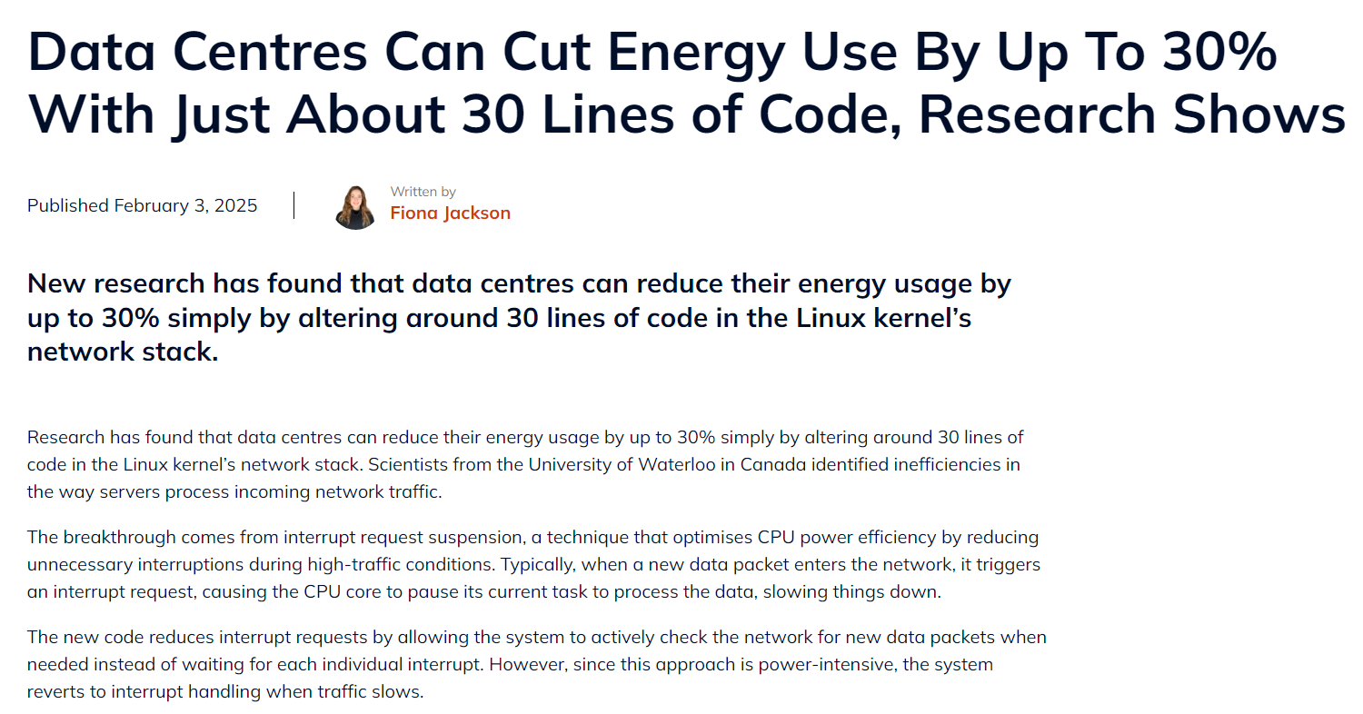
https://www.techrepublic.com/article/data-centres-energy-reduction-code/
Notes:
We have a lot of experience with current architectures, and based software on them.
https://www.techrepublic.com/article/data-centres-energy-reduction-code/

Slide 22
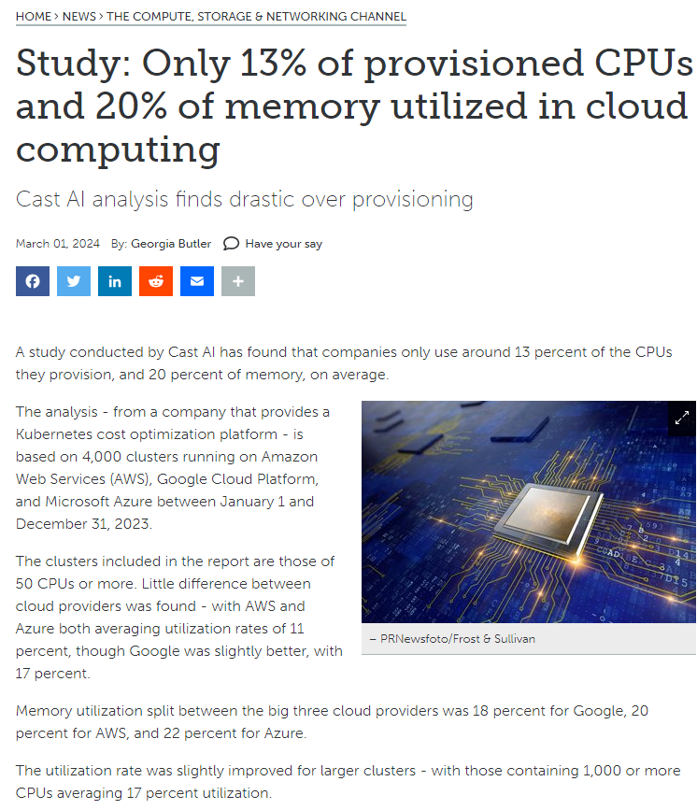
https://www.datacenterdynamics.com/en/news/only-13-of-provisioned-cpus-and-20-of-memory-utilized-in-cloud-computing-report/
Notes:
https://www.datacenterdynamics.com/en/news/only-13-of-provisioned-cpus-and-20-of-memory-utilized-in-cloud-computing-report/

Slide 23
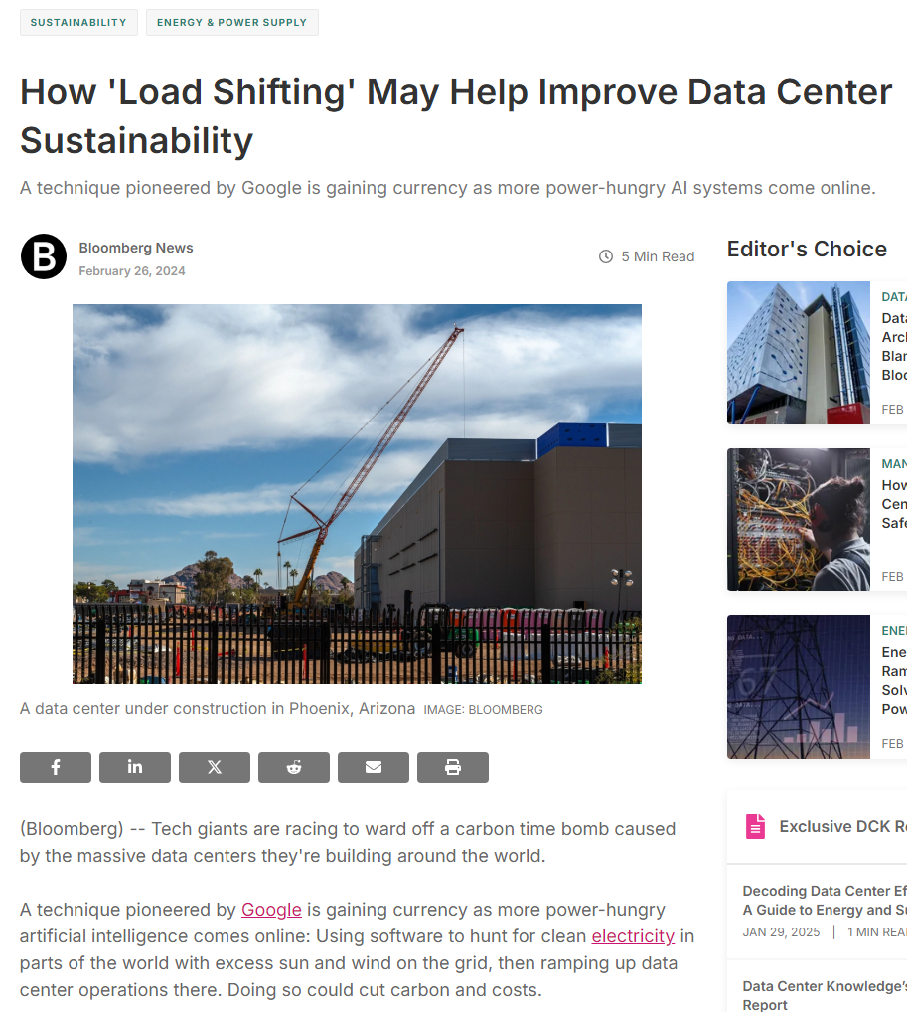
“By chasing the sun from Europe to the US West Coast and back again, the company was able to slash computing emissions for certain workloads for itself and clients by 34% rather than relying on servers in either location alone”
https://www.bloomberg.com/news/articles/2024-02-25/ai-increases-data-center-energy-use-google-pioneered-technique-could-help
Notes:
https://www.bloomberg.com/news/articles/2024-02-25/ai-increases-data-center-energy-use-google-pioneered-technique-could-help

Slide 24
Policy options
Require green software for government software, including transparency (sharing data) for government IT.
Invest more in European software (compared to hardware), and de-incentive not used capacity.
Introduce flexibility when & where IT is used (don’t require ‘as soon as possible’ results)
(does the government IT systems needs to be available on Christmas night?). Don’t rely on green certificates (not useful anymore).
Tax digital services to pay for projects of digital inclusion and avoid energy poverty

Slide 25
Our contributions

Slide 26
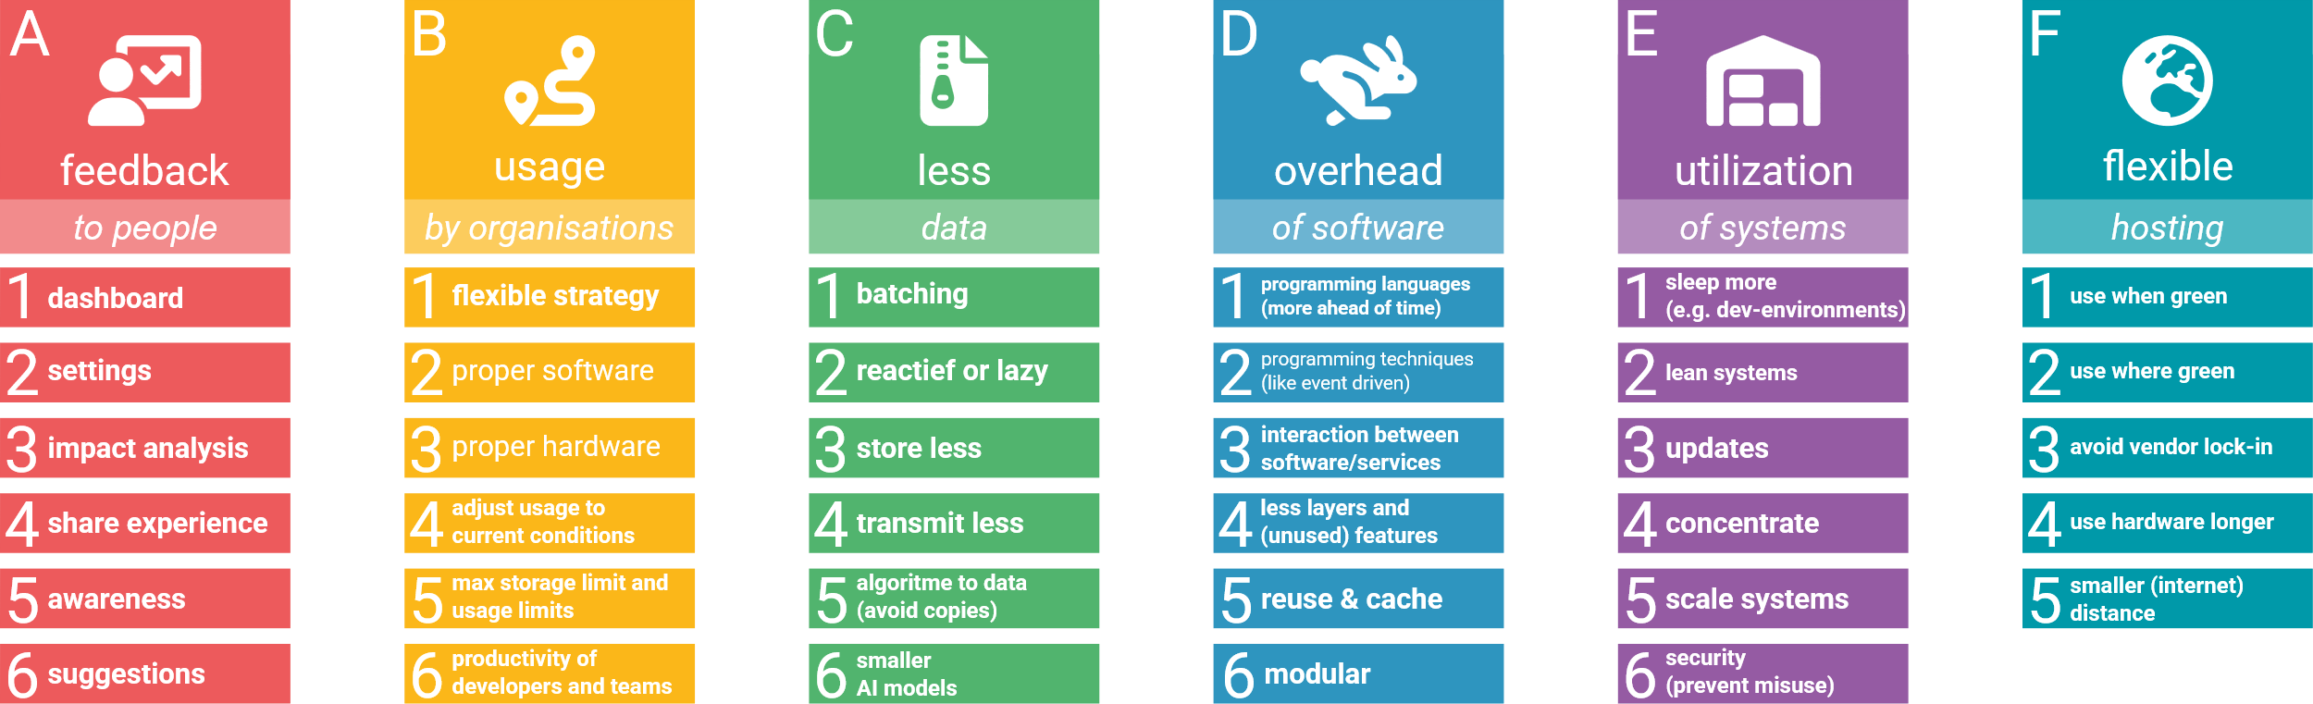
Infographic green software strategies
Notes:
Compiler technology that generate specialized code for different architectures
Visualization of energy consumption in code
Adjusting operating systems and libraries for improved hardware control
Sustainability by design
Green software architecture
…

Slide 27
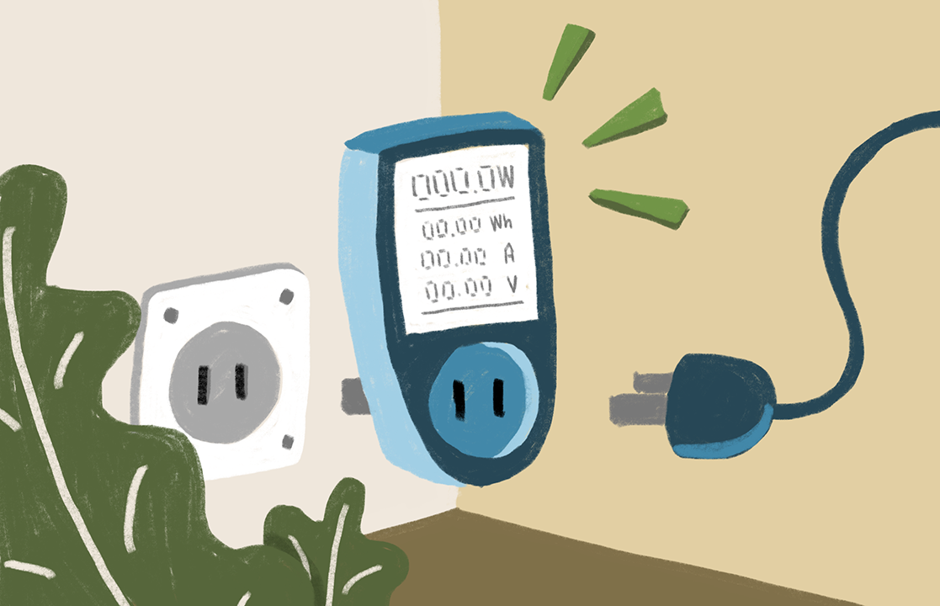
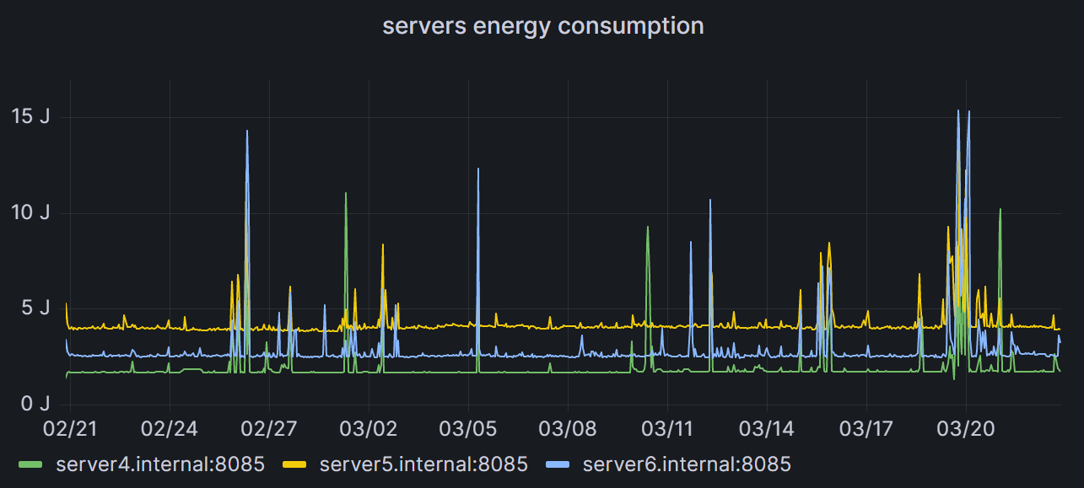
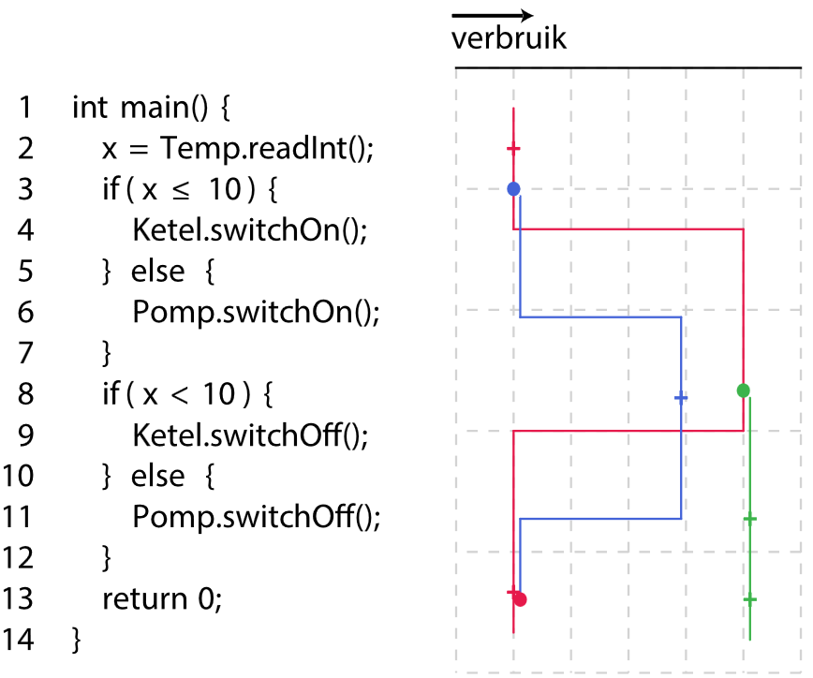
Measuring is hard
Inside the processor (RAPL)
Storage + motherboard not included
Power supply (Corsair HX1000i)
No official calibration exists
Wall socket
Actual goal, however, sample frequency limit to 50Hz
Software Energy Lab

Slide 28



Scientific focus aeras:
Pedagogical
professionalization
AI technology
Ethics
Sustainable data
Co-creation with:
Schools
Companies
Academia
Notes:
Techno-optimisme + technofix
Bestaande verschillen groter

Slide 29
Thanks!
Bernard.vanGastel@ru.nl
Bernard van Gastel
LinkedIn: bvgastel
Assistant professor sustainable digitalization
https://sustainablesoftware.info
Software Science, Radboud University

